Slide 1
Contents:
Cookie
Cache
SAP
ERP

Slide 2
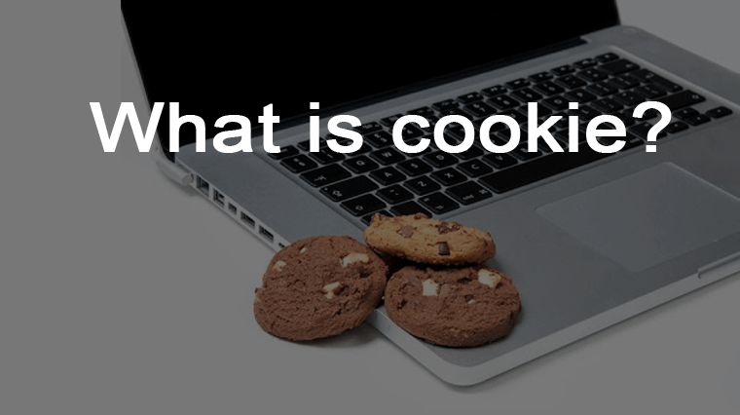
What is Cookie

Slide 3
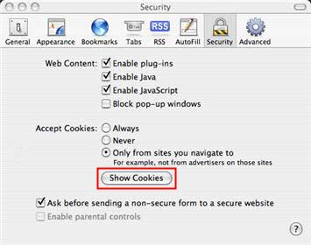
A cookie is a small text file that is downloaded and saved to your hard drive when you visit a website. This text file contains information that can be read by the web server the next time you visit that same site.
Cookies are used in a number of ways. One common use of cookies is to store login information for a website you visit frequently. That way you don’t have to enter your user name and password each time you visit the site. Another use of cookies is to track items you have added to a shopping cart while you visit an online vendor such as Amazon.com.
The cookie can keep track of the items you select while navigating through the different sections until you decide to go to the check out page and purchase them. Cookies can also be used to save information you enter in a form.

Slide 4
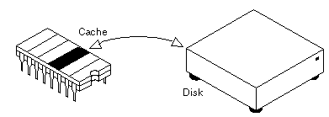
What is Cache in Computer

Slide 5
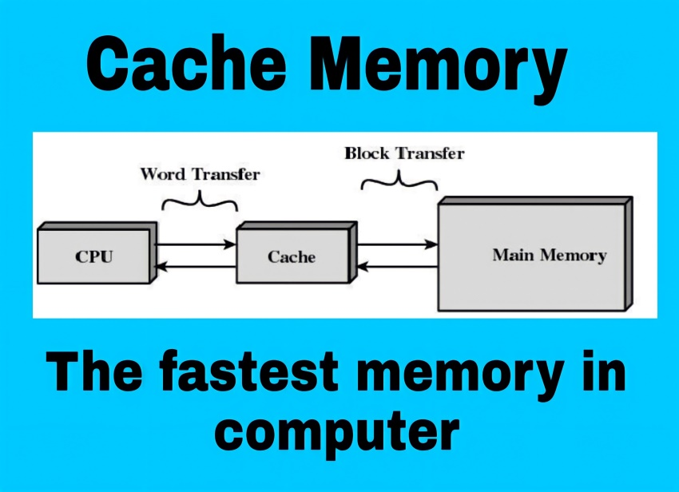
Cache is also used to refer to any temporary collection of data either in hardware or software. For instance, regular maintenance suggests you restart your computer, router, and modem on a regular basis to clear the cache letting your devices load programs faster.
When you go to your Google history to erase your browser cookies and search, one of the options is to clear “cached images.”
When techies in computers talk about the cache they are most likely referring to cache memory.

Slide 6
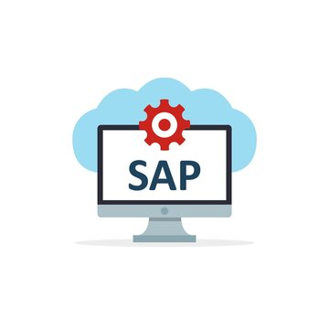
What is SAP

Slide 7
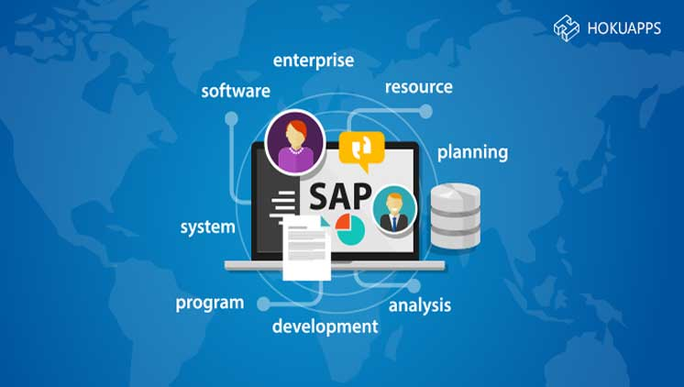
SAP is an enterprise resource planning software. SAP is the most-used ERP software in the market and contains hundreds of fully integrated modules covering nearly every aspect of business management. Using SAP creates a centralised system for businesses that enables every department to access and share data to create a better work environment for every employee.

Slide 8
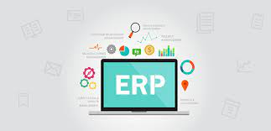
What is ERP

Slide 9
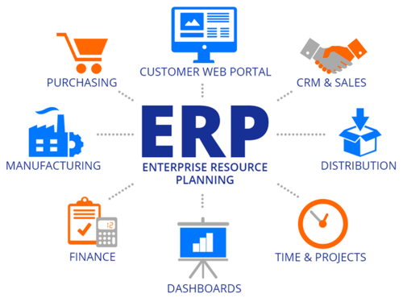
Enterprise resource planning (ERP)refers to a type of software that organizations use to manage day-to-day business activities such as accounting, procurement, project management, risk management and compliance, and supply chain operations. A complete ERP suite also includes enterprise performance management , software that helps plan, budget, predict, and report on an organization’s financial results.
ERP systems tie together a multitude of business processes and enable the flow of data between them. By collecting an organization’s shared transactional data from multiple sources, ERP systems eliminate data duplication and provide data integrity with a single source of truth.
Today, ERP systems are critical for managing thousands of businesses of all sizes and in all industries. To these companies, ERP is as indispensable as the electricity that keeps the lights on.

